Slide 1
India crop production analysis

Slide 2
Objective:
Development of a dashboard that analyzes te agricultural pattern in india that can help the farmers as well as the end consumer, hence contributing to nations economy.
Benefits:
Helps farmers track the supply & demand of crops
Helps the supply chain to allocate agricultural area according to demand & supply’

Slide 3
Data Sharing Agreement :
Sample file name
Length of date stamp(8 digits)
Length of time stamp(6 digits)
Number of Columns
Column names
Column data type

Slide 4
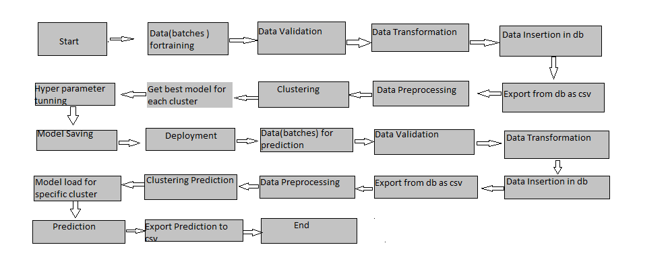
Architecture

Slide 5
Data Validation and Data Transformation :
Name Validation - Validation of files name as per the DSA. We have created a regex pattern for validation. After it checks for date format and time format if these requirements are satisfied, we move such files to "Good_Data_Folder" else "Bad_Data_Folder.“
Number of Columns – Validation of number of columns present in the files, and if it doesn't match then the file is moved to "Bad_Data_Folder.“
Name of Columns - The name of the columns is validated and should be the same as given in the schema file. If not, then the file is moved to "Bad_Data_Folder".
Data type of columns - The data type of columns is given in the schema file. It is validated when we insert the files into Database. If the datatype is wrong, then the file is moved to "Bad_Data_Folder".
Null values in columns - If any of the columns in a file have all the values as NULL or missing, we discard such a file and move it to "Bad_Data_Folder".

Slide 6
Data Insertion in Database:
Table creation :- Table name “crop_production.csv" is created in the database for inserting the files. If the table is already present then new files are inserted in the same table.
Insertion of files in the table - All the files in the "Good_Data_Folder" are inserted in the above-created table. If any file has invalid data type in any of the columns, the file is not loaded in the table

Slide 7
Model Training:
Data Export from Db :
The accumulated data from db is exported in csv format for model training
Data Preprocessing
Performing EDA to get insight of data like identifying distribution , outliers ,trend
among data etc.
Check for null values in the columns. If present impute the null values.
Encode the categorical values with numeric values.
Perform Standard Scalar to scale down the values.

Slide 8
Q & A:
Q1) What’s the source of data?
The data for training is provided by the client in multiple batches and each batch contain multiple files
Q 2) What was the type of data?
The data was the combination of numerical and Categorical values.
Q 3) What’s the complete flow you followed in this Project?
Refer slide 5th for better Understanding
Q 4) After the File validation what you do with incompatible file or files which didn’t pass the validation?
Files like these are moved to the Achieve Folder and a list of these files has been
shared with the client and we removed the bad data folder.

Slide 9
Q 5) How logs are managed?
We are using different logs as per the steps that we follow in validation and
modeling like File validation log , Data Insertion ,Model Training log , prediction log
etc.
Q 6) What techniques were you using for data pre-processing?
Removing unwanted attributes
Visualizing relation of independent variables with each other and output variables
Checking and changing Distribution of continuous values
Removing outliers
Cleaning data and imputing if null values are present.
Converting categorical data into numeric values.
Scaling the data

